Slide 1
Digital Design & Computer Arch. Lecture 6: Sequential Logic Design
Prof. Onur Mutlu
ETH Zürich
Spring 2020
6 March 2020

Slide 2
We Are Almost Done with This
Building blocks of modern computers
Transistors
Logic gates
Combinational circuits
Boolean algebra
How to use Boolean algebra to represent combinational circuits
Minimizing logic circuits

Slide 3
Agenda for Today and Next Week
Today
Wrap up Combinational Logic and Circuit Minimization
Start (and finish) Sequential Logic
Next week
Hardware Description Languages and Verilog
Combinational Logic
Sequential Logic
Timing and Verification

Slide 4
Assignment: Required Lecture Video
Why study computer architecture?
Why is it important?
Future Computing Architectures
Required Assignment
Watch Prof. Mutlu’s inaugural lecture at ETH and understand it
https://www.youtube.com/watch?v=kgiZlSOcGFM
Optional Assignment – for 1% extra credit
Write a 1-page summary of the lecture and email us
What are your key takeaways?
What did you learn?
What did you like or dislike?
Submit your summary to Moodle – Deadline: April 1

Slide 5
Extra Assignment: Moore’s Law (I)
Paper review
G.E. Moore. "Cramming more components onto integrated circuits," Electronics magazine, 1965
Optional Assignment – for 1% extra credit
Write a 1-page review
Upload PDF file to Moodle – Deadline: April 1
I strongly recommend that you follow my guidelines for (paper) review (see next slide)

Slide 6
Extra Assignment 2: Moore’s Law (II)
Guidelines on how to review papers critically
Guideline slides: pdf ppt
Video: https://www.youtube.com/watch?v=tOL6FANAJ8c
Example reviews on “Main Memory Scaling: Challenges and Solution Directions” (link to the paper)
Review 1
Review 2
Example review on “Staged memory scheduling: Achieving high performance and scalability in heterogeneous systems” (link to the paper)
Review 1

Slide 7
Assignment: Required Readings
Combinational Logic
P&P Chapter 3 until 3.3 + H&H Chapter 2
Sequential Logic
P&P Chapter 3.4 until end + H&H Chapter 3 in full
Hardware Description Languages and Verilog
H&H Chapter 4 in full
Timing and Verification
H&H Chapters 2.9 and 3.5 + (start Chapter 5)
By the end of next week, make sure you are done with
P&P Chapters 1-3 + H&H Chapters 1-4

Slide 8
Wrap-Up Combinational Logic Circuits and Design

Slide 9
Recall: Tri-State Buffer
A tri-state buffer enables gating of different signals onto a wire
Floating signal (Z): Signal that is not driven by any circuit
Open circuit, floating wire

Slide 10
Recall: Example: Use of Tri-State Buffers
Imagine a wire connecting the CPU and memory
At any time only the CPU or the memory can place a value on the wire, both not both
You can have two tri-state buffers: one driven by CPU, the other memory; and ensure at most one is enabled at any time

Slide 11
Recall: Example Design with Tri-State Buffers
GateCPU
CPU
GateMem
Memory
Shared Bus

Slide 12
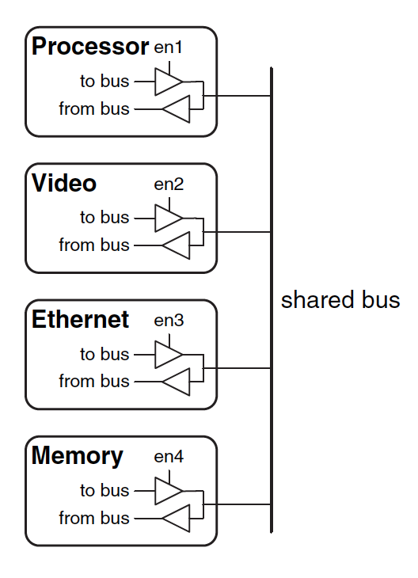
Recall: Another Example

Slide 13
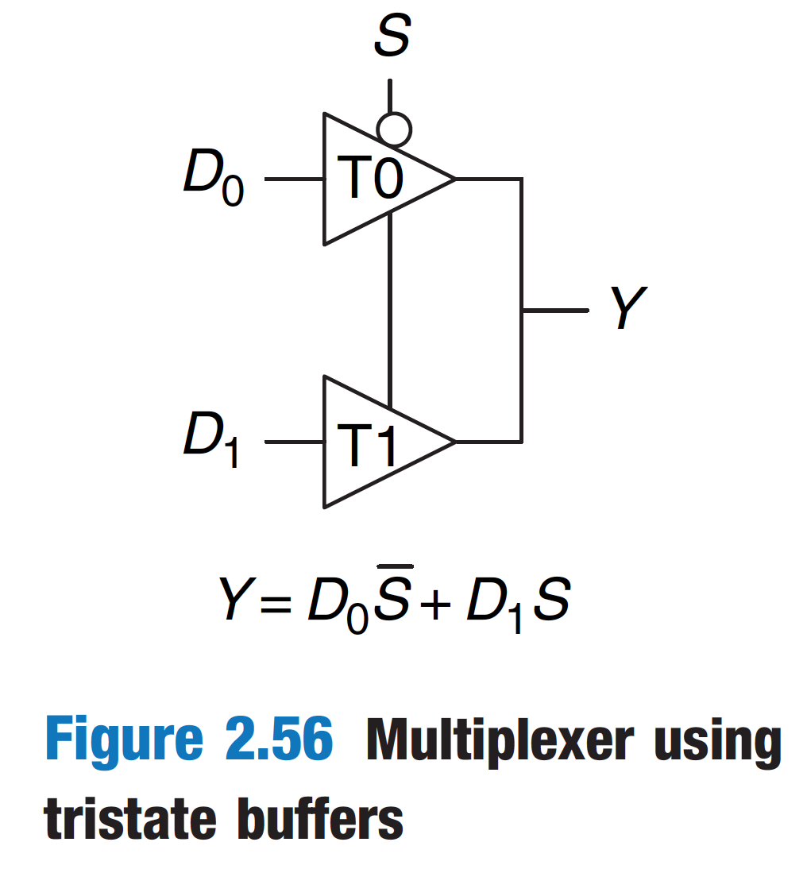
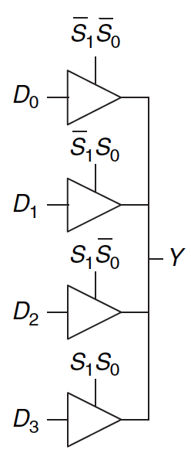
Multiplexer Using Tri-State Buffers

Slide 14
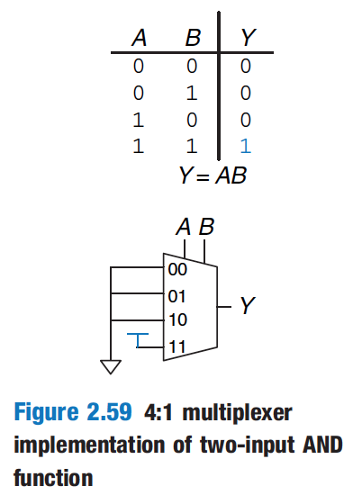
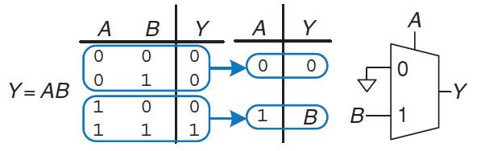
Aside: Logic Using Multiplexers
Multiplexers can be used as lookup tables to perform logic functions

Slide 15
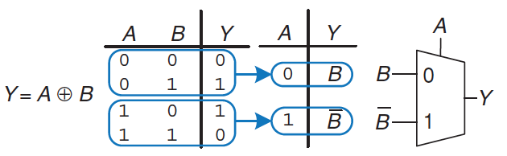
Aside: Logic Using Multiplexers (II)
Multiplexers can be used as lookup tables to perform logic functions

Slide 16
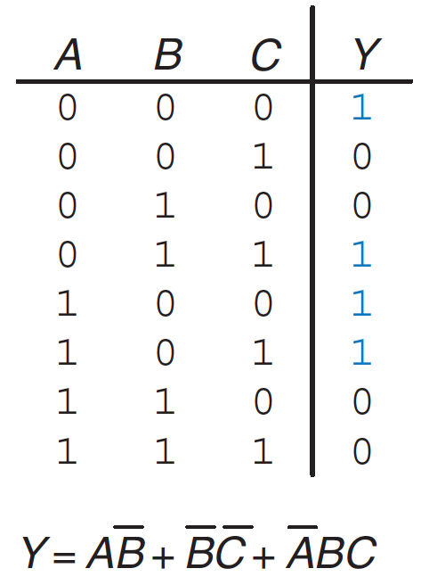
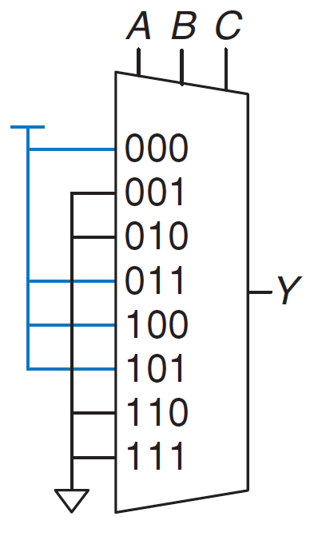
Aside: Logic Using Multiplexers (III)
Multiplexers can be used as lookup tables to perform logic functions
Read H&H Chapter 2.8

Slide 17
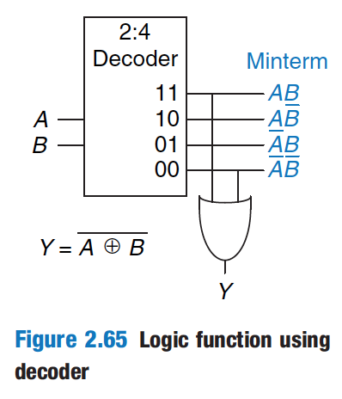
Aside: Logic Using Decoders (I)
Decoders can be combined with OR gates to build logic functions.
Read H&H Chapter 2.8

Slide 18
Logic Simplification using Boolean Algebra Rules

Slide 19
Recall: Full Adder in SOP Form Logic
Full Adder

Slide 20
Goal: Simplified Full Adder
How do we simplify Boolean logic?

Slide 21
Quick Recap on Logic Simplification
The original Boolean expression (i.e., logic circuit) may not be optimal
Can we reduce a given Boolean expression to an equivalent expression with fewer terms?
The goal of logic simplification:
Reduce the number of gates/inputs
Reduce implementation cost
F = ~A(A + B) + (B + AA)(A + ~B)
F = A + B
A basis for what the automated design tools are doing today

Slide 22
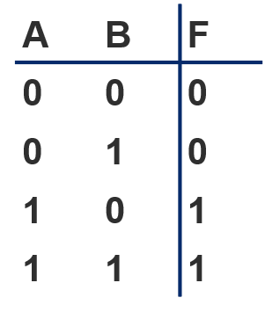
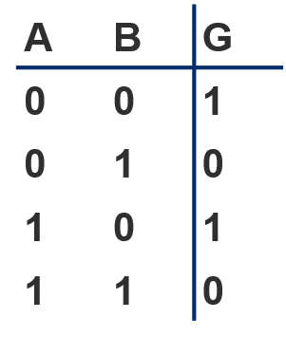
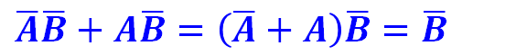
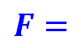
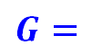
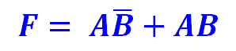
Logic Simplification
Systematic techniques for simplifications
amenable to automation
$$F= A\overline{B}+AB$$
Key Tool: The Uniting Theorem —
$F=$
$$A\overline{B}+AB=A\left(\overline{B}+B\right)=A\left(1\right)=A$$
Essence of Simplification:
Find two element subsets of the ON-set where only one variable changes its value. This single varying variable can be eliminated!
B's value changes within the rows where F==1 (“ON set”)
A's value does NOT change within the ON-set rows
If an input (B) can change without changing the output, that input value is not needed
➙ B is eliminated, A remains
$G=$
$\overline{A}\overline{B}+A\overline{B}=\left(\overline{A}+A\right)\overline{B}=\overline{B}$
B's value stays the same within the ON-set rows
A's value changes within the ON-set rows
➙ A is eliminated, B remains

Slide 23
Logic Simplification: Karnaugh Maps (K-Maps)

Slide 24
Karnaugh Maps are Fun…
A pictorial way of minimizing circuits by visualizing opportunities for simplification
They are for you to study on your own…
See Backup Slides
Read H&H Section 2.7
Watch videos of Lectures 5 and 6 from 2019 Digitech course:
https://youtu.be/0ks0PeaOUjE?list=PL5Q2soXY2Zi8J58xLKBNFQFHRO3GrXxA9&t=4570
https://youtu.be/ozs18ARNG6s?list=PL5Q2soXY2Zi8J58xLKBNFQFHRO3GrXxA9&t=220

Slide 25
Sequential Logic Circuits and Design

Slide 26
What We Will Learn Today
Circuits that can store information
Cross-coupled inverter
R-S Latch
Gated D Latch
D Flip-Flop
Register
Finite State Machines (FSM)
Moore Machine
Mealy Machine
Verilog implementations of sequential circuits (next week)

Slide 27
Circuits that Can Store Information

Slide 28
Introduction
Combinational circuit output depends only on current input
We want circuits that produce output depending on current and past input values – circuits with memory
How can we design a circuit that stores information?
Sequential Circuit
inputs
Combinational
Circuit
outputs
Storage
Element

Slide 29
Capturing Data

Slide 30
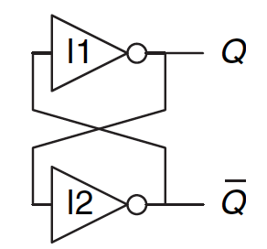
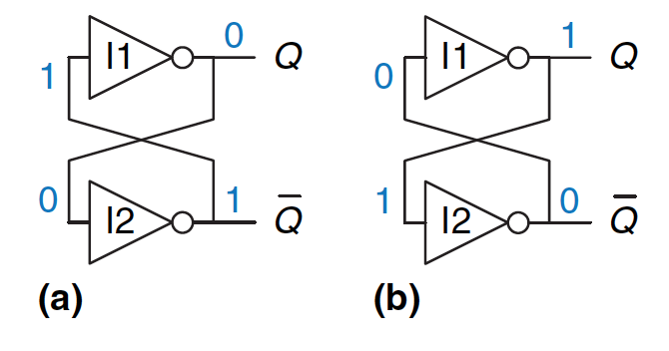
Basic Element: Cross-Coupled Inverters
Has two stable states: Q=1 or Q=0.
Has a third possible “metastable” state with both outputs oscillating between 0 and 1 (we will see this later)
Not useful without a control mechanism for setting Q
Image source: Harris and Harris, Digital Design and Computer Architecture, 2nd Ed., p.110.

Slide 31
More Realistic Storage Elements
Have a control mechanism for setting Q
We will see the R-S latch soon
Let’s look at an SRAM (static random access memory) cell first
We will get back to SRAM (and DRAM) later
SRAM cell

Slide 32
The Big Picture: Storage Elements
Latches and Flip-Flops
Very fast, parallel access
Very expensive (one bit costs tens of transistors)
Static RAM (SRAM)
Relatively fast, only one data word at a time
Expensive (one bit costs 6+ transistors)
Dynamic RAM (DRAM)
Slower, one data word at a time, reading destroys content (refresh), needs special process for manufacturing
Cheap (one bit costs only one transistor plus one capacitor)
Other storage technology (flash memory, hard disk, tape)
Much slower, access takes a long time, non-volatile
Very cheap

Slide 33
Basic Storage Element: The R-S Latch

Slide 34
The R-S (Reset-Set) Latch
Cross-coupled NAND gates
Data is stored at Q (inverse at Q’)
S and R are control inputs
In quiescent (idle) state, both S and R are held at 1
S (set): drive S to 0 (keeping R at 1) to change Q to 1
R (reset): drive R to 0 (keeping S at 1) to change Q to 0
S and R should never both be 0 at the same time
S
Q
Input |  | Output
R | S | Q
1 | 1 | Q_{prev}
1 | 0 | 1
0 | 1 | 0
0 | 0 | Forbidden
R
Q’

Slide 35
Why not R=S=0?
1
0
S
Q
Input |  | Output
R | S | Q
1 | 1 | Q_{prev}
1 | 0 | 1
0 | 1 | 0
0 | 0 | Forbidden
1
0
1
0
R
0
Q’
1
If R=S=0, Q and Q’ will both settle to 1, which breaks our invariant that Q = !Q’
If S and R transition back to 1 at the same time, Q and Q’ begin to oscillate between 1 and 0 because their final values depend on each other (metastability)
This eventually settles depending on variation in the circuits (more metastability to come in Lecture 8)

Slide 36
The Gated D Latch

Slide 37
The Gated D Latch
How do we guarantee correct operation of an R-S Latch?
S
Q
Q’
R

Slide 38
The Gated D Latch
How do we guarantee correct operation of an R-S Latch?
Add two more NAND gates!
Q takes the value of D, when write enable (WE) is set to 1
S and R can never be 0 at the same time!
D
S
Q
Write
Enable
Q’
R

Slide 39
The Gated D Latch
D
S
Q
Write
Enable
R
Q’
Input |  | Output
WE | D | Q
0 | 0 | Q_{prev}
0 | 1 | Q_{prev}
1 | 0 | 0
1 | 1 | 1

Slide 40
The Register

Slide 41
The Register
How can we use D latches to store more data?
Use more D latches!
A single WE signal for all latches for
simultaneous writes
Here we have a register, or a structure that stores more than one bit and can be read from and written to
This register holds 4 bits, and its data is referenced as Q[3:0]
D
D₂
D₁
D₀
₃
Write Enable
₃
Q
Q₂
Q₁
Q₀

Slide 42
The Register
How can we use D latches to store more data?
Use more D latches!
A single WE signal for all latches for
simultaneous writes
Here we have a register, or a structure that stores more than one bit and can be read from and written to
This register holds 4 bits, and its data is referenced as Q[3:0]
D_{3:0}
4
Register x (Rx)
WE
4
Q_{3:0}

Slide 43
Memory

Slide 44
Memory
Memory is comprised of locations that can be written to or read from. An example memory array with 4 locations:
Every unique location in memory is indexed with a unique address. 4 locations require 2 address bits (log[#locations]).
Addressability: the number of bits of information stored in each location. This example: addressability is 8 bits.
The entire set of unique locations in memory is referred to as the address space.
Typical memory is MUCH larger (billions of locations)
Addr(00):
0100 1001
Addr(01):
0100 1011
Addr(10):
0010 0010
Addr(11):
1100 1001

Slide 45
Addressing Memory
Let’s implement a simple memory array with:
3-bit addressability & address space size of 2 (total of 6 bits)
1 Bit
D
Q
WE
6-Bit Memory Array
Bit₂
Bit₁
Bit₀
Addr(0)
Bit₂
Bit₁
Bit₀
Addr(1)
Notes:
Memory array

Slide 46
Reading from Memory
How can we select the address to read?
Because there are 2 addresses, address size is log(2)=1 bit
Notes:
How do we read from memory?

Slide 47
Reading from Memory
How can we select an address to read?
Because there are 2 addresses, address size is log(2)=1 bit
Addr[0]
Wordline
D[2]
D[1]
D[0]

Slide 48
Reading from Memory
How can we select an address to read?
Because there are 2 addresses, address size is log(2)=1 bit
Addr[0]
Wordline
Address Decoder
D[2]
D[1]
D[0]

Slide 49
Reading from Memory
How can we select an address to read?
Because there are 2 addresses, address size is log(2)=1 bit
Addr[0]
Wordline
Address Decoder
D[2]
D[1]
D[0]
Multiplexer

Slide 50
Writing to Memory
How can we select an address and write to it?
Notes:
How can we write to memory?

Slide 51
Writing to Memory
How can we select an address and write to it?
Input is indicated with D_{i}
Addr[0]
D_{i}[2]
D_{i}[1]
D_{i}[0]
WE

Slide 52
Putting it all Together
Let’s enable reading and writing to a memory array
Addr[0]
D_{i}[2]
D_{i}[1]
D_{i}[0]
WE
D[2]
D[1]
D[0]
Notes:
Putting it all together...

Slide 53
A Bigger Memory Array
Addr[1:0]
D_{i}[2]
D_{i}[1]
D_{i}[0]
WE
D[2]
D[1]
D[0]
Notes:
A bigger memory array

Slide 54
A Bigger Memory Array
Addr[1:0]
D_{i}[2]
D_{i}[1]
D_{i}[0]
WE
Address Decoder
Multiplexer
D[2]
D[1]
D[0]

Slide 55
Sequential Logic Circuits

Slide 56
Sequential Logic Circuits
We have looked at designs of circuit elements that can store information
Now, we will use these elements to build circuits that remember past inputs
Combinational
Only depends on current inputs
Sequential
Opens depending on past inputs
https://www.easykeys.com/228_ESP_Combination_Lock.aspx
https://www.fosmon.com/product/tsa-approved-lock-4-dial-combo

Slide 57
State
In order for this lock to work, it has to keep track (remember) of the past events!
If passcode is R13-L22-R3, sequence of states to unlock:
The lock is not open (locked), and no relevant operations have been performed
Locked but user has completed R13
Locked but user has completed R13-L22
Unlocked: user has completed R13-L22-R3
The state of a system is a snapshot of all relevant elements of the system at the moment of the snapshot
To open the lock, states A-D must be completed in order
If anything else happens (e.g., L5), lock returns to state A

Slide 58
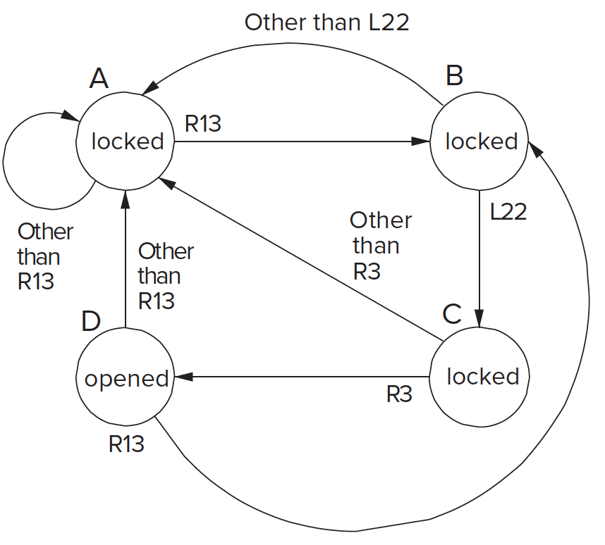
State Diagram of Our Sequential Lock
Completely describes the operation of the sequential lock
We will understand “state diagrams” fully later today
Image source: Patt and Patel, “Introduction to Computing Systems”, 2nd ed., page 76.

Slide 59
Another Simple Example of State
A standard Swiss traffic light has 4 states
Green
Yellow
Red
Red and Yellow
The sequence of these states are always as follows
A
B
C
D

Slide 60
Changing State: The Notion of Clock (I)
A
B
C
D
When should the light change from one state to another?
We need a clock to dictate when to change state
Clock signal alternates between 0 & 1
At the start of a clock cycle ( ), system state changes
During a clock cycle, the state stays constant
In this traffic light example, we are assuming the traffic light stays in each state an equal amount of time
1
CLK:
0

Slide 61
Changing State: The Notion of Clock (II)
Clock is a general mechanism that triggers transition from one state to another in a sequential circuit
Clock synchronizes state changes across many sequential circuit elements
Combinational logic evaluates for the length of the clock cycle
Clock cycle should be chosen to accommodate maximum combinational circuit delay
More on this later, when we discuss timing

Slide 62
Finite State Machines

Slide 63
Finite State Machines
What is a Finite State Machine (FSM)?
A discrete-time model of a stateful system
Each state represents a snapshot of the system at a given time
An FSM pictorially shows
1. the set of all possible states that a system can be in
2. how the system transitions from one state to another
An FSM can model
A traffic light, an elevator, fan speed, a microprocessor, etc.
An FSM enables us to pictorially think of a stateful system using simple diagrams

Slide 64
Finite State Machines (FSMs) Consist of:
Five elements:
A finite number of states
State: snapshot of all relevant elements of the system at the time of the snapshot
A finite number of external inputs
A finite number of external outputs
An explicit specification of all state transitions
How to get from one state to another
An explicit specification of what determines each external output value

Slide 65
Finite State Machines (FSMs)
Each FSM consists of three separate parts:
next state logic
state register
output logic
state register
At the beginning of the clock cycle, next state is latched into the state register

Slide 66
Finite State Machines (FSMs) Consist of:
Sequential circuits
State register(s)
Store the current state and
Load the next state at the clock edge
Combinational Circuits
Next state logic
Determines what the next state will be
Output logic
Generates the outputs
Notes:
discuss DFlipFlop here. Latch doesn't do this, so we need sequential circuit that stores state and loads next state at the clock edge. next state is available for the full clock cycle
now lets take a look at this.

Slide 67
Finite State Machines (FSMs) Consist of:
Sequential circuits
State register(s)
Store the current state and
Load the next state at the clock edge
Combinational Circuits
Next state logic
Determines what the next state will be
Output logic
Generates the outputs
Notes:
discuss DFlipFlop here. Latch doesn't do this, so we need sequential circuit that stores state and loads next state at the clock edge. next state is available for the full clock cycle
now lets take a look at this.

Slide 68
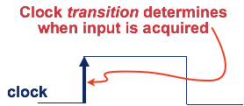
State Register Implementation
How can we implement a state register? Two properties:
1. We need to store data at the beginning of every clock cycle
2. The data must be available during the entire clock cycle
1
CLK:
0
Register
Input:
Register
Output:
Desired behavior
Notes:
Introduce clock much earlier maybe.
input data is sampled once.

Slide 69
The Problem with Latches
Recall the
Gated D Latch
D
Q
CLK = WE
Currently, we cannot simply wire a clock to WE of a latch
Whenever the clock is high, the latch propagates D to Q
The latch is transparent
1
CLK:
0
Register
Input:
Register
Output:

Slide 70
The Problem with Latches
Recall the
Gated D Latch
D
Q
CLK = WE
Currently, we cannot simply wire a clock to WE of a latch
Whenever the clock is high, the latch propagates D to Q
The latch is transparent
1
CLK:
0
Register
Input:
Register
Output:
Undesirable!

Slide 71
The Problem with Latches
Recall the
Gated D Latch
D
Q
CLK = WE
Currently, we cannot simply wire a clock to WE of a latch
When the clock is high Q will not take on D’s value AND
When the clock is low the latch will propagate D to Q
How can we change the latch, so that
1) D (input) is observable at Q (output)
only at the beginning of next clock cycle?
2) Q is available for the full clock cycle
1
CLK:
0
Input:
Output:

Slide 72
The Need for a New Storage Element
To design viable FSMs
We need storage elements that allow us
to read the current state throughout the current clock cycle
AND
not write the next state values into the storage elements until the beginning of the next clock cycle.

Slide 73
The D Flip-Flop
1) state change on clock edge, 2) data available for full cycle
D Latch (Master)
D
D Latch (Slave)
Q
CLK
1
CLK:
0
When the clock is low, master propagates D to the input of slave (Q unchanged)
Only when the clock is high, slave latches D (Q stores D)
At the rising edge of clock (clock going from 0->1), Q gets assigned D

Slide 74
The D Flip-Flop
1) state change on clock edge, 2) data available for full cycle
D
Q
CLK
__
Q
D Flip-Flop
1
CLK:
0
At the rising edge of clock (clock going from 0->1), Q gets assigned D
At all other times, Q is unchanged

Slide 75
The D Flip-Flop
How do we implement this?
D
Q
CLK
We can use these Flip-Flops
to implement the state register!
__
Q
D Flip-Flop
1
CLK:
0
At the rising edge of clock (clock going from 0->1), Q gets assigned D
At all other times, Q is unchanged

Slide 76
Rising-Clock-Edge Triggered Flip-Flop
Two inputs: CLK, D
Function
The flip-flop “samples” D on the rising edge
of CLK (positive edge)
When CLK rises from 0 to 1, D passes
through to Q
Otherwise, Q holds its previous value
Q changes only on the rising edge of CLK
A flip-flop is called an edge-triggered state element because it captures data on the clock edge
A latch is a level-triggered state element
CLK

Slide 77
Register
Multiple parallel flip-flops, each of which storing 1 bit
Condensed
This line represents 4 wires
This register stores 4 bits

Slide 78
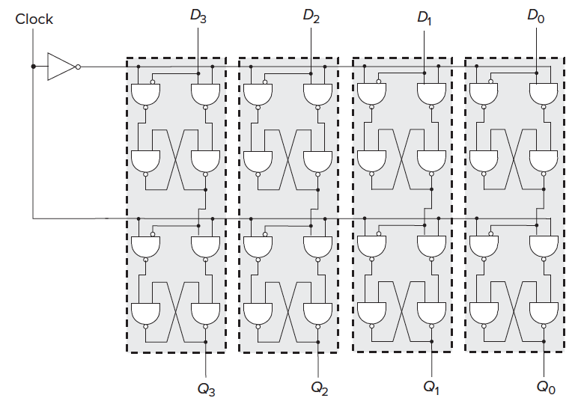
A 4-Bit D-Flip-Flop-Based Register (Internally)
Image source: Patt and Patel, “Introduction to Computing Systems”, 3rd ed., tentative page 95.

Slide 79
Finite State Machines (FSMs)
Next state is determined by the current state and the inputs
Two types of finite state machines differ in the output logic:
Moore FSM: outputs depend only on the current state

Slide 80
Finite State Machines (FSMs)
Next state is determined by the current state and the inputs
Two types of finite state machines differ in the output logic:
Moore FSM: outputs depend only on the current state
Mealy FSM: outputs depend on the current state and the inputs

Slide 81
Finite State Machine Example
“Smart” traffic light controller
2 inputs:
Traffic sensors: T_{A} , T_{B} (TRUE when there’s traffic)
2 outputs:
Lights: L_{A} , L_{B} (Red, Yellow, Green)
State can change every 5 seconds
Except if green and traffic, stay green
From H&H Section 3.4.1

Slide 82
Finite State Machine Black Box
Inputs: CLK, Reset, T_{A} , T_{B}
Outputs: L_{A} , L_{B}

Slide 83
Finite State Machine Transition Diagram
Moore FSM: outputs labeled in each state
States: Circles
Transitions: Arcs

Slide 84
Finite State Machine Transition Diagram
Moore FSM: outputs labeled in each state
States: Circles
Transitions: Arcs

Slide 85
Finite State Machine Transition Diagram
Moore FSM: outputs labeled in each state
States: Circles
Transitions: Arcs

Slide 86
Finite State Machine Transition Diagram
Moore FSM: outputs labeled in each state
States: Circles
Transitions: Arcs

Slide 87
Finite State Machine Transition Diagram
Moore FSM: outputs labeled in each state
States: Circles
Transitions: Arcs

Slide 88
Finite State Machine: State Transition Table

Slide 89
FSM State Transition Table
Current State | Inputs |  | Next State
S | T_{A} | T_{B} | S'
S0 | 0 | X
S0 | 1 | X
S1 | X | X
S2 | X | 0
S2 | X | 1
S3 | X | X

Slide 90
FSM State Transition Table
Current State | Inputs |  | Next State
S | T_{A} | T_{B} | S'
S0 | 0 | X | S1
S0 | 1 | X | S0
S1 | X | X | S2
S2 | X | 0 | S3
S2 | X | 1 | S2
S3 | X | X | S0

Slide 91
FSM State Transition Table
Current State | Inputs |  | Next State
S | T_{A} | T_{B} | S'
S0 | 0 | X | S1
S0 | 1 | X | S0
S1 | X | X | S2
S2 | X | 0 | S3
S2 | X | 1 | S2
S3 | X | X | S0
State | Encoding
S0 | 00
S1 | 01
S2 | 10
S3 | 11

Slide 92
FSM State Transition Table
Current State |  | Inputs |  | Next State
S₁ | S₀ | T_{A} | T_{B} | S’₁ | S’₀
0 | 0 | 0 | X | 0 | 1
0 | 0 | 1 | X | 0 | 0
0 | 1 | X | X | 1 | 0
1 | 0 | X | 0 | 1 | 1
1 | 0 | X | 1 | 1 | 0
1 | 1 | X | X | 0 | 0
State | Encoding
S0 | 00
S1 | 01
S2 | 10
S3 | 11

Slide 93
FSM State Transition Table
Current State |  | Inputs |  | Next State
S₁ | S₀ | T_{A} | T_{B} | S’₁ | S’₀
0 | 0 | 0 | X | 0 | 1
0 | 0 | 1 | X | 0 | 0
0 | 1 | X | X | 1 | 0
1 | 0 | X | 0 | 1 | 1
1 | 0 | X | 1 | 1 | 0
1 | 1 | X | X | 0 | 0
State | Encoding
S0 | 00
S1 | 01
S2 | 10
S3 | 11
S’₁ = ?

Slide 94
FSM State Transition Table
Current State |  | Inputs |  | Next State
S₁ | S₀ | T_{A} | T_{B} | S’₁ | S’₀
0 | 0 | 0 | X | 0 | 1
0 | 0 | 1 | X | 0 | 0
0 | 1 | X | X | 1 | 0
1 | 0 | X | 0 | 1 | 1
1 | 0 | X | 1 | 1 | 0
1 | 1 | X | X | 0 | 0
State | Encoding
S0 | 00
S1 | 01
S2 | 10
S3 | 11
S’₁ = (S₁ ∙ S₀) + (S₁ ∙ S₀ ∙ T_{B}) + (S₁ ∙ S₀ ∙ T_{B})

Slide 95
FSM State Transition Table
Current State |  | Inputs |  | Next State
S₁ | S₀ | T_{A} | T_{B} | S’₁ | S’₀
0 | 0 | 0 | X | 0 | 1
0 | 0 | 1 | X | 0 | 0
0 | 1 | X | X | 1 | 0
1 | 0 | X | 0 | 1 | 1
1 | 0 | X | 1 | 1 | 0
1 | 1 | X | X | 0 | 0
State | Encoding
S0 | 00
S1 | 01
S2 | 10
S3 | 11
S’₁ = (S₁ ∙ S₀) + (S₁ ∙ S₀ ∙ T_{B}) + (S₁ ∙ S₀ ∙ T_{B})
S’₀ = ?

Slide 96
FSM State Transition Table
Current State |  | Inputs |  | Next State
S₁ | S₀ | T_{A} | T_{B} | S’₁ | S’₀
0 | 0 | 0 | X | 0 | 1
0 | 0 | 1 | X | 0 | 0
0 | 1 | X | X | 1 | 0
1 | 0 | X | 0 | 1 | 1
1 | 0 | X | 1 | 1 | 0
1 | 1 | X | X | 0 | 0
State | Encoding
S0 | 00
S1 | 01
S2 | 10
S3 | 11
S’₁ = (S₁ ∙ S₀) + (S₁ ∙ S₀ ∙ T_{B}) + (S₁ ∙ S₀ ∙ T_{B})
S’₀ = (S₁ ∙ S₀ ∙ T_{A}) + (S₁ ∙ S₀ ∙ T_{B})

Slide 97
FSM State Transition Table
Current State |  | Inputs |  | Next State
S₁ | S₀ | T_{A} | T_{B} | S’₁ | S’₀
0 | 0 | 0 | X | 0 | 1
0 | 0 | 1 | X | 0 | 0
0 | 1 | X | X | 1 | 0
1 | 0 | X | 0 | 1 | 1
1 | 0 | X | 1 | 1 | 0
1 | 1 | X | X | 0 | 0
State | Encoding
S0 | 00
S1 | 01
S2 | 10
S3 | 11
S’₁ = S₁ xor S₀ (Simplified)
S’₀ = (S₁ ∙ S₀ ∙ T_{A}) + (S₁ ∙ S₀ ∙ T_{B})

Slide 98
Finite State Machine: Output Table

Slide 99
FSM Output Table
Current State |  | Outputs
S₁ | S₀ | L_{A} | L_{B}
0 | 0 | green | red
0 | 1 | yellow | red
1 | 0 | red | green
1 | 1 | red | yellow

Slide 100
FSM Output Table
Current State |  | Outputs
S₁ | S₀ | L_{A} | L_{B}
0 | 0 | green | red
0 | 1 | yellow | red
1 | 0 | red | green
1 | 1 | red | yellow
Output | Encoding
green | 00
yellow | 01
red | 10
70

Slide 101
FSM Output Table
Current State |  | Outputs
S₁ | S₀ | L_{A1} | L_{A0} | L_{B1} | L_{B0}
0 | 0 | 0 | 0 | 1 | 0
0 | 1 | 0 | 1 | 1 | 0
1 | 0 | 1 | 0 | 0 | 0
1 | 1 | 1 | 0 | 0 | 1
Output | Encoding
green | 00
yellow | 01
red | 10
L_{A1} = S₁

Slide 102
FSM Output Table
Current State |  | Outputs
S₁ | S₀ | L_{A1} | L_{A0} | L_{B1} | L_{B0}
0 | 0 | 0 | 0 | 1 | 0
0 | 1 | 0 | 1 | 1 | 0
1 | 0 | 1 | 0 | 0 | 0
1 | 1 | 1 | 0 | 0 | 1
Output | Encoding
green | 00
yellow | 01
red | 10
L_{A1} = S₁
L_{A0} = S₁ ∙ S₀

Slide 103
FSM Output Table
Current State |  | Outputs
S₁ | S₀ | L_{A1} | L_{A0} | L_{B1} | L_{B0}
0 | 0 | 0 | 0 | 1 | 0
0 | 1 | 0 | 1 | 1 | 0
1 | 0 | 1 | 0 | 0 | 0
1 | 1 | 1 | 0 | 0 | 1
Output | Encoding
green | 00
yellow | 01
red | 10
L_{A1} = S₁
L_{A0} = S₁ ∙ S₀
L_{B1} = S₁

Slide 104
FSM Output Table
Current State |  | Outputs
S₁ | S₀ | L_{A1} | L_{A0} | L_{B1} | L_{B0}
0 | 0 | 0 | 0 | 1 | 0
0 | 1 | 0 | 1 | 1 | 0
1 | 0 | 1 | 0 | 0 | 0
1 | 1 | 1 | 0 | 0 | 1
Output | Encoding
green | 00
yellow | 01
red | 10
L_{A1} = S₁
L_{A0} = S₁ ∙ S₀
L_{B1} = S₁
L_{B0} = S₁ ∙ S₀

Slide 105
Digital Design & Computer Arch. Lecture 6: Sequential Logic Design
Prof. Onur Mutlu
ETH Zürich
Spring 2020
6 March 2020

Slide 106
We did not cover the remaining slides. They are for your preparation for the next lecture.

Slide 107
Finite State Machine: Schematic

Slide 108
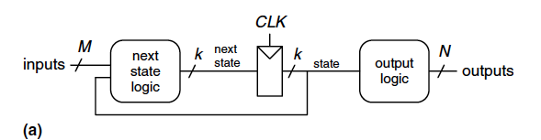
FSM Schematic: State Register

Slide 109
FSM Schematic: State Register

Slide 110
FSM Schematic: Next State Logic
S’₁ = S₁ xor S₀
S’₀ = (S₁ ∙ S₀ ∙ T_{A}) + (S₁ ∙ S₀ ∙ T_{B})

Slide 111
FSM Schematic: Output Logic
L_{A1} = S₁
L_{A0} = S₁ ∙ S₀
L_{B1} = S₁
L_{B0} = S₁ ∙ S₀

Slide 112
FSM Timing Diagram
T_{A}
Reset
__
S0
L_{A}: yellow
L_{B}: red
T_{A}
S1
L_{A}: yellow
L_{B}: red
S3
L_{A}: red
L_{B}: yellow
S2
L_{A}: red
L_{B}: green
__
T_{B}
T_{B}

Slide 113
FSM Timing Diagram
T_{A}
Reset
__
S0
L_{A}: yellow
L_{B}: red
T_{A}
S1
L_{A}: yellow
L_{B}: red
S3
L_{A}: red
L_{B}: yellow
S2
L_{A}: red
L_{B}: green
__
T_{B}
T_{B}

Slide 114
FSM Timing Diagram
T_{A}
Reset
__
S0
L_{A}: yellow
L_{B}: red
T_{A}
S1
L_{A}: yellow
L_{B}: red
S3
L_{A}: red
L_{B}: yellow
S2
L_{A}: red
L_{B}: green
__
T_{B}
T_{B}

Slide 115
FSM Timing Diagram
T_{A}
Reset
__
S0
L_{A}: yellow
L_{B}: red
T_{A}
S1
L_{A}: yellow
L_{B}: red
S3
L_{A}: red
L_{B}: yellow
S2
L_{A}: red
L_{B}: green
__
T_{B}
T_{B}

Slide 116
FSM Timing Diagram
T_{A}
Reset
__
S0
L_{A}: yellow
L_{B}: red
T_{A}
S1
L_{A}: yellow
L_{B}: red
S3
L_{A}: red
L_{B}: yellow
S2
L_{A}: red
L_{B}: green
__
T_{B}
T_{B}

Slide 117
FSM Timing Diagram
T_{A}
Reset
__
S0
L_{A}: yellow
L_{B}: red
T_{A}
S1
L_{A}: yellow
L_{B}: red
S3
L_{A}: red
L_{B}: yellow
S2
L_{A}: red
L_{B}: green
__
T_{B}
T_{B}

Slide 118
FSM Timing Diagram
T_{A}
Reset
__
S0
L_{A}: yellow
L_{B}: red
T_{A}
S1
L_{A}: yellow
L_{B}: red
S3
L_{A}: red
L_{B}: yellow
S2
L_{A}: red
L_{B}: green
__
T_{B}
T_{B}

Slide 119
FSM Timing Diagram
T_{A}
Reset
__
S0
L_{A}: yellow
L_{B}: red
T_{A}
S1
L_{A}: yellow
L_{B}: red
S3
L_{A}: red
L_{B}: yellow
S2
L_{A}: red
L_{B}: green
__
T_{B}
This is from H&H Section 3.4.1
T_{B}

Slide 120
FSM Timing Diagram
T_{A}
Reset
__
S0
L_{A}: yellow
L_{B}: red
T_{A}
S1
L_{A}: yellow
L_{B}: red
S3
L_{A}: red
L_{B}: yellow
S2
L_{A}: red
L_{B}: green
__
T_{B}
T_{B}

Slide 121
FSM Timing Diagram
T_{A}
Reset
__
S0
L_{A}: yellow
L_{B}: red
T_{A}
S1
L_{A}: yellow
L_{B}: red
See H&H Chapter 3.4
S3
L_{A}: red
L_{B}: yellow
S2
L_{A}: red
L_{B}: green
__
T_{B}
T_{B}

Slide 122
Finite State Machine: State Encoding

Slide 123
FSM State Encoding
How do we encode the state bits?
Three common state binary encodings with different tradeoffs
Fully Encoded
1-Hot Encoded
Output Encoded
Let’s see an example Swiss traffic light with 4 states
Green, Yellow, Red, Yellow+Red

Slide 124
FSM State Encoding (II)
Binary Encoding (Full Encoding):
Use the minimum number of bits used to encode all states
Use log₂(num_states) bits to represent the states
Example states: 00, 01, 10, 11
Minimizes # flip-flops, but not necessarily output logic or next state logic
One-Hot Encoding:
Each bit encodes a different state
Uses num_states bits to represent the states
Exactly 1 bit is “hot” for a given state
Example states: 0001, 0010, 0100, 1000
Simplest design process – very automatable
Maximizes # flip-flops, minimizes next state logic

Slide 125
FSM State Encoding (III)
Output Encoding:
Outputs are directly accessible in the state encoding
For example, since we have 3 outputs (light color), encode state with 3 bits, where each bit represents a color
Example states: 001, 010, 100, 110
Bit₀ encodes green light output,
Bit₁ encodes yellow light output
Bit₂ encodes red light output
Minimizes output logic
Only works for Moore Machines (output function of state)

Slide 126
FSM State Encoding (III)
Output Encoding:
Outputs are directly accessible in the state encoding
For example, since we have 3 outputs (light color), encode state with 3 bits, where each bit represents a color
Example states: 001, 010, 100, 110
Bit₀ encodes green light output,
Bit₁ encodes yellow light output
Bit₂ encodes red light output
Minimizes output logic
Only works for Moore Machines (output function of state)
The designer must carefully choose
an encoding scheme to optimize the design under given constraints

Slide 127
Moore vs. Mealy Machines

Slide 128
Recall: Moore vs. Mealy FSMs
Next state is determined by the current state and the inputs
Two types of finite state machines differ in the output logic:
Moore FSM: outputs depend only on the current state
Mealy FSM: outputs depend on the current state and the inputs

Slide 129
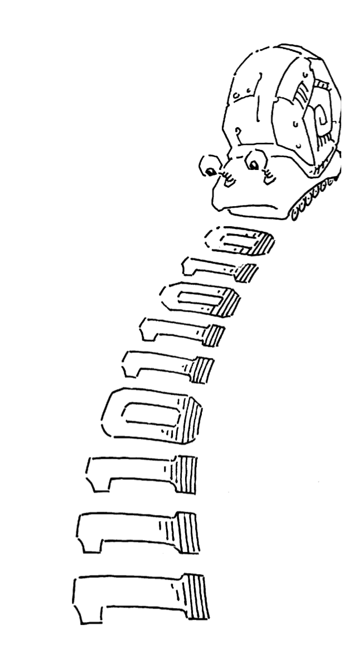
Moore vs. Mealy FSM Examples
Alyssa P. Hacker has a snail that crawls down a paper tape with 1’s and 0’s on it.
The snail smiles whenever the last four digits it has crawled over are 1101.
Design Moore and Mealy FSMs of the snail’s brain.

Slide 130
Moore vs. Mealy FSM Examples
Alyssa P. Hacker has a snail that crawls down a paper tape with 1’s and 0’s on it.
The snail smiles whenever the last four digits it has crawled over are 1101.
Design Moore and Mealy FSMs of the snail’s brain.

Slide 131
State Transition Diagrams
What are the tradeoffs?

Slide 132
FSM Design Procedure
Determine all possible states of your machine
Develop a state transition diagram
Generally this is done from a textual description
You need to 1) determine the inputs and outputs for each state and 2) figure out how to get from one state to another
Approach
Start by defining the reset state and what happens from it – this is typically an easy point to start from
Then continue to add transitions and states
Picking good state names is very important
Building an FSM is like programming (but it is not programming!)
An FSM has a sequential “control-flow” like a program with conditionals and goto’s
The if-then-else construct is controlled by one or more inputs
The outputs are controlled by the state or the inputs
In hardware, we typically have many concurrent FSMs

Slide 133
What is to Come: LC-3 Processor

Slide 134
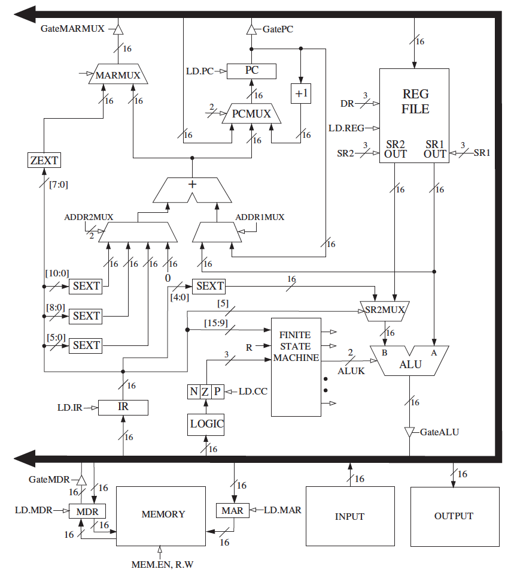
What is to Come: LC-3 Datapath

Slide 135
Backup Slides: Different Types of Flip Flops

Slide 136
Enabled Flip-Flops
Inputs: CLK, D, EN
The enable input (EN) controls when new data (D) is stored
Function:
EN = 1: D passes through to Q on the clock edge
EN = 0: the flip-flop retains its previous state

Slide 137
Resettable Flip-Flop
Inputs: CLK, D, Reset
The Reset is used to set the output to 0.
Function:
Reset = 1: Q is forced to 0
Reset = 0: the flip-flop behaves like an ordinary D flip-flop

Slide 138
Resettable Flip-Flops
Two types:
Synchronous: resets at the clock edge only
Asynchronous: resets immediately when Reset = 1
Asynchronously resettable flip-flop requires changing the internal circuitry of the flip-flop (see Exercise 3.10)
Synchronously resettable flip-flop?

Slide 139
Settable Flip-Flop
Inputs: CLK, D, Set
Function:
Set = 1: Q is set to 1
Set = 0: the flip-flop behaves like an ordinary D flip-flop

Slide 140
Logic Simplification: Karnaugh Maps (K-Maps)

Slide 141
Logic Simplification
Systematic techniques for simplifications
amenable to automation
$$F= A\overline{B}+AB$$
Key Tool: The Uniting Theorem —
$F=$
$$A\overline{B}+AB=A\left(\overline{B}+B\right)=A\left(1\right)=A$$
Essence of Simplification:
Find two element subsets of the ON-set where only one variable changes its value. This single varying variable can be eliminated!
B's value changes within the rows where F==1 (“ON set”)
A's value does NOT change within the ON-set rows
If an input (B) can change without changing the output, that input value is not needed
➙ B is eliminated, A remains
$G=$
$\overline{A}\overline{B}+A\overline{B}=\left(\overline{A}+A\right)\overline{B}=\overline{B}$
B's value stays the same within the ON-set rows
A's value changes within the ON-set rows
➙ A is eliminated, B remains

Slide 142
Complex Cases
One example
Problem
Easy to see how to apply Uniting Theorem…
Hard to know if you applied it in all the right places…
…especially in a function of many more variables
Question
Is there an easier way to find potential simplifications?
i.e., potential applications of Uniting Theorem…?
Answer
Need an intrinsically geometric representation for Boolean f( )
Something we can draw, see…
$$Cout=\overline{A}BC+A\overline{B}C+AB\overline{C}+ABC$$

Slide 143






Karnaugh Map
Karnaugh Map (K-map) method
K-map is an alternative method of representing the truth table that helps visualize adjacencies in up to 6 dimensions
Physical adjacency ↔ Logical adjacency
 |  | 0 | 1
0 |  | 00 | 01
1 |  | 10 | 11
 |  | 00 | 01 | 11 | 10
0 |  | 000 | 001 | 011 | 010
1 |  | 100 | 101 | 111 | 110
 |  | 00 | 01 | 11 | 10
00 |  | 0000 | 0001 | 0011 | 0010
01 |  | 0100 | 0101 | 0111 | 0110
11 |  | 1100 | 1101 | 1111 | 1110
10 |  | 1000 | 1001 | 1011 | 1010
2-variable K-map
3-variable K-map
4-variable K-map
$$B$$
$$BC$$
$$CD$$
$$A$$
$$AB$$
$$A$$
Numbering Scheme: 00, 01, 11, 10 is called a
“Gray Code” — only a single bit (variable) changes
from one code word and the next code word

Slide 144

Karnaugh Map Methods
Adjacent
 |  | 00 | 01 | 11 | 10
0 |  | 000 | 001 | 011 | 010
1 |  | 100 | 101 | 111 | 110
$$BC$$
$$A$$
000
010
110
100
001
011
111
101
000
010
110
100
001
011
111
101
Adjacent
K-map adjacencies go “around the edges”
Wrap around from first to last column
Wrap around from top row to bottom row

Slide 145


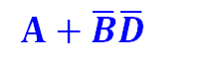

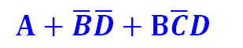
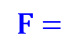
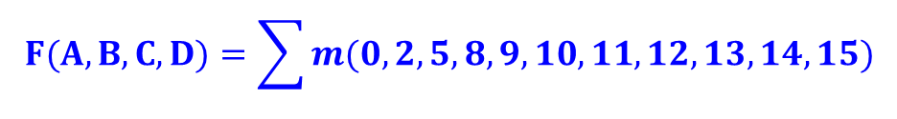
K-map Cover - 4 Input Variables
 |  | 00 | 01 | 11 | 10
00 |  | 1 | 0 | 0 | 1
01 |  | 0 | 1 | 0 | 0
11 |  | 1 | 1 | 1 | 1
10 |  | 1 | 1 | 1 | 1
$$F(A,B,C,D)=\sum{m(0,2,5,8,9,10,11,12,13,14,15)}$$
$$CD$$
$$AB$$
$$A+\overline{B}\overline{D}+B\overline{C}D$$
$$F=$$
$$A$$
$$A+\overline{B}\overline{D}$$
Strategy for “circling” rectangles on Kmap:
As big as possible
Biggest “oops!” that people forget:
Wrap-arounds

Slide 146
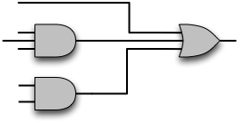
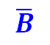


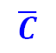


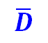
Example: As Logic Gates
What does this solution look like as gates?
$$B\overline{C}D+A+\overline{B}\overline{D}$$
$$A$$
$$\overline{C}$$
$$B$$
$$D$$
$$\overline{B}$$
$$\overline{D}$$

Slide 147
Logic Minimization Using K-Maps
Very simple guideline:
Circle all the rectangular blocks of 1’s in the map, using the fewest possible number of circles
Each circle should be as large as possible
Read off the implicants that were circled
More formally:
A Boolean equation is minimized when it is written as a sum of the fewest number of prime implicants
Each circle on the K-map represents an implicant
The largest possible circles are prime implicants

Slide 148
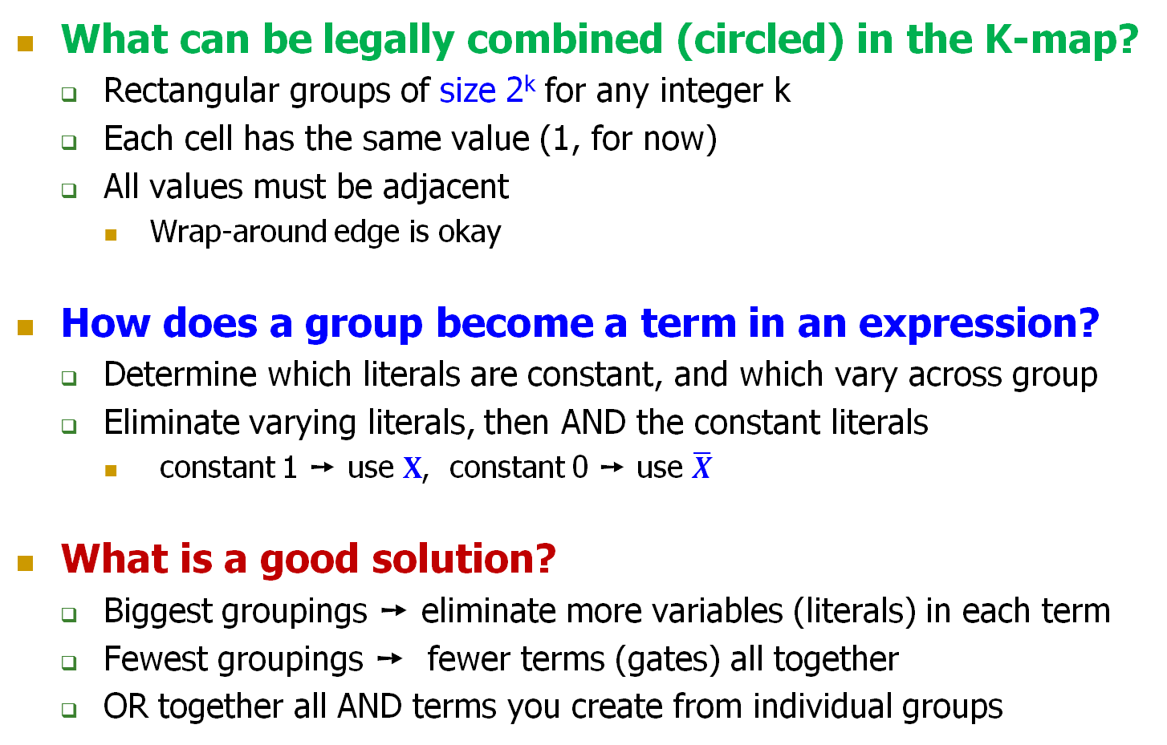
K-map Rules
What can be legally combined (circled) in the K-map?
Rectangular groups of size 2^{k} for any integer k
Each cell has the same value (1, for now)
All values must be adjacent
Wrap-around edge is okay
How does a group become a term in an expression?
Determine which literals are constant, and which vary across group
Eliminate varying literals, then AND the constant literals
constant 1 ➙ use $X$, constant 0 ➙ use $\overline{X}$
What is a good solution?
Biggest groupings ➙ eliminate more variables (literals) in each term
Fewest groupings ➙ fewer terms (gates) all together
OR together all AND terms you create from individual groups

Slide 149
K-map Example: Two-bit Comparator
A | B | C | D | F1 | F2 | F3
0 | 0 | 0 | 0 | 1 | 0 | 0
0 | 0 | 0 | 1 | 0 | 1 | 0
0 | 0 | 1 | 0 | 0 | 1 | 0
0 | 0 | 1 | 1 | 0 | 1 | 0
0 | 1 | 0 | 0 | 0 | 0 | 1
0 | 1 | 0 | 1 | 1 | 0 | 0
0 | 1 | 1 | 0 | 0 | 1 | 0
0 | 1 | 1 | 1 | 0 | 1 | 0
1 | 0 | 0 | 0 | 0 | 0 | 1
1 | 0 | 0 | 1 | 0 | 0 | 1
1 | 0 | 1 | 0 | 1 | 0 | 0
1 | 0 | 1 | 1 | 0 | 1 | 0
1 | 1 | 0 | 0 | 0 | 0 | 1
1 | 1 | 0 | 1 | 0 | 0 | 1
1 | 1 | 1 | 0 | 0 | 0 | 1
1 | 1 | 1 | 1 | 1 | 0 | 0
 | A
 |  | F1 | AB = CD
 | B
 |  | F2 | AB < CD
 | C
 |  | F3 | AB > CD
 | D
Design Approach:
Write a 4-Variable K-map
for each of the 3
output functions

Slide 150






K-map Example: Two-bit Comparator (2)
 |  | 00 | 01 | 11 | 10
00 |  | 1
01 |  |  | 1
11 |  |  |  | 1
10 |  |  |  |  | 1
K-map for F1
A | B | C | D | F1 | F2 | F3
0 | 0 | 0 | 0 | 1 | 0 | 0
0 | 0 | 0 | 1 | 0 | 1 | 0
0 | 0 | 1 | 0 | 0 | 1 | 0
0 | 0 | 1 | 1 | 0 | 1 | 0
0 | 1 | 0 | 0 | 0 | 0 | 1
0 | 1 | 0 | 1 | 1 | 0 | 0
0 | 1 | 1 | 0 | 0 | 1 | 0
0 | 1 | 1 | 1 | 0 | 1 | 0
1 | 0 | 0 | 0 | 0 | 0 | 1
1 | 0 | 0 | 1 | 0 | 0 | 1
1 | 0 | 1 | 0 | 1 | 0 | 0
1 | 0 | 1 | 1 | 0 | 1 | 0
1 | 1 | 0 | 0 | 0 | 0 | 1
1 | 1 | 0 | 1 | 0 | 0 | 1
1 | 1 | 1 | 0 | 0 | 0 | 1
1 | 1 | 1 | 1 | 1 | 0 | 0
$$C$$
$$CD$$
$$AB$$
$$B$$
$$A$$
$$D$$
F1 =
A'B'C'D' + A'BC'D + ABCD + AB'CD'

Slide 151



K-map Example: Two-bit Comparator (3)
 |  | 00 | 01 | 11 | 10
00 |  |  | 1 | 1 | 1
01 |  |  |  | 1 | 1
11
10 |  |  |  | 1
K-map for F2
A | B | C | D | F1 | F2 | F3
0 | 0 | 0 | 0 | 1 | 0 | 0
0 | 0 | 0 | 1 | 0 | 1 | 0
0 | 0 | 1 | 0 | 0 | 1 | 0
0 | 0 | 1 | 1 | 0 | 1 | 0
0 | 1 | 0 | 0 | 0 | 0 | 1
0 | 1 | 0 | 1 | 1 | 0 | 0
0 | 1 | 1 | 0 | 0 | 1 | 0
0 | 1 | 1 | 1 | 0 | 1 | 0
1 | 0 | 0 | 0 | 0 | 0 | 1
1 | 0 | 0 | 1 | 0 | 0 | 1
1 | 0 | 1 | 0 | 1 | 0 | 0
1 | 0 | 1 | 1 | 0 | 1 | 0
1 | 1 | 0 | 0 | 0 | 0 | 1
1 | 1 | 0 | 1 | 0 | 0 | 1
1 | 1 | 1 | 0 | 0 | 0 | 1
1 | 1 | 1 | 1 | 1 | 0 | 0
$$C$$
$$CD$$
$$AB$$
$$B$$
$$A$$
$$D$$
F2 =
A'C + A'B'D + B'CD
F3 =
? (Exercise for you)

Slide 152
K-maps with “Don’t Care”
Don’t Care really means I don’t care what my circuit outputs if this appears as input
You have an engineering choice to use DON’T CARE patterns intelligently as 1 or 0 to better simplify the circuit
A | B | C | D | F | G
• • •
0 | 1 | 1 | 0 | X | X
0 | 1 | 1 | 1
1 | 0 | 0 | 0 | X | X
1 | 0 | 0 | 1
• • •
I can pick 00, 01, 10, 11
independently of below
I can pick 00, 01, 10, 11
independently of above

Slide 153
Example: BCD Increment Function
BCD (Binary Coded Decimal) digits
Encode decimal digits 0 - 9 with bit patterns 0000₂ — 1001₂
When incremented, the decimal sequence is 0, 1, …, 8, 9, 0, 1
A | B | C | D | W | X | Y | Z
0 | 0 | 0 | 0 | 0 | 0 | 0 | 1
0 | 0 | 0 | 1 | 0 | 0 | 1 | 0
0 | 0 | 1 | 0 | 0 | 0 | 1 | 1
0 | 0 | 1 | 1 | 0 | 1 | 0 | 0
0 | 1 | 0 | 0 | 0 | 1 | 0 | 1
0 | 1 | 0 | 1 | 0 | 1 | 1 | 0
0 | 1 | 1 | 0 | 0 | 1 | 1 | 1
0 | 1 | 1 | 1 | 1 | 0 | 0 | 0
1 | 0 | 0 | 0 | 1 | 0 | 0 | 1
1 | 0 | 0 | 1 | 0 | 0 | 0 | 0
1 | 0 | 1 | 0 | X | X | X | X
1 | 0 | 1 | 1 | X | X | X | X
1 | 1 | 0 | 0 | X | X | X | X
1 | 1 | 0 | 1 | X | X | X | X
1 | 1 | 1 | 0 | X | X | X | X
1 | 1 | 1 | 1 | X | X | X | X
These input patterns should
never be encountered in practice
(hey -- it’s a BCD number!)
So, associated output values are
“Don’t Cares”

Slide 154






K-map for BCD Increment Function
Z (without don’t cares) = A'D' + B'C'D’
Z (with don’t cares) = D'
W
 |  | 00 | 01 | 11 | 10
00
01 |  |  |  | 1
11 |  | X | X | X | X
10 |  | 1 |  | X | X
X
 |  | 00 | 01 | 11 | 10
00 |  |  |  | 1
01 |  | 1 | 1 |  | 1
11 |  | X | X | X | X
10 |  |  |  | X | X
$$CD$$
$$CD$$
A B C D
+ 1
W X Y Z
$$AB$$
$$AB$$
Y
 |  | 00 | 01 | 11 | 10
00 |  |  | 1 |  | 1
01 |  |  | 1 |  | 1
11 |  | X | X | X | X
10 |  |  |  | X | X
Z
 |  | 00 | 01 | 11 | 10
00 |  | 1 |  |  | 1
01 |  | 1 |  |  | 1
11 |  | X | X | X | X
10 |  | 1 |  | X | X
$$CD$$
$$C$$
$$CD$$
$$AB$$
$$AB$$
$$B$$
$$A$$
$$D$$

Slide 155
K-map Summary
Karnaugh maps as a formal systematic approach for logic simplification
2-, 3-, 4-variable K-maps
K-maps with “Don’t Care” outputs
H&H Section 2.7

